Slide 1

https://www.facebook.com/tesseractspl
https://www.linkedin.com/company-beta/11222535/

Slide 2

Identity and Access management

Slide 3
AGENDA
What is IAM?
Features of IAM
Accessing IAM
Overview of Identity Management: Users
IAM Users
Federating Existing Users
Overview of Access Management: Policies & Permissions
Policies and Groups
IAM Roles

Slide 4

What is IAM?
Amazon Identity and Access management is web service which is helps you to securely access and manage your aws resources for your users. You use IAM to control who can use your AWS console(authentication) and how they can use your resources(authorization).

Slide 5

Features of IAM
Shared access to your AWS account.
Granular permissions.
Secure access to AWS resources for application that run on AWS EC2.
Multi-factor authentication(MFA).
Identity federation.
Identity information for assurance.
PCI DSS compliance.
Integrated with many AWS services.
Eventually consistence.
Free to use.

Slide 6
Accessing IAM
You can work with AWS IAM in any of following way:
AWS management console
The console is a browser-based interface to mange IAM and AWS resources.
AWS Command Line Tools
You can use the AWS command line tools to issue commands at your system's
command line to perform IAM and AWS tasks.
AWS SDKs
AWS provides SDKs (software development kits) that consist of libraries and sample
code for various programming languages and platforms (Java, Python, Ruby, .NET,
iOS, Android, etc.).
IAM HTTPS API
You can access IAM and AWS programmatically by using the IAM HTTPS API,
which lets you issue HTTPS requests directly to the service.

Slide 7
Overview of Identity Management: Users
For greater security and organization, you can give access to your AWS account to specific users—identities that you create with custom permissions. You can further simplify access for those users by federating existing identities into AWS.
Following are the ways to access your AWS account:
First time access only : Your root user credentials
IAM Users

Slide 8
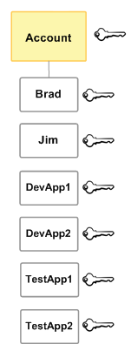
IAM Users
Instead of sharing your root user credentials with others, you can create individual IAM users within your account that correspond to users in your organization. IAM users are not separate accounts; they are users within your account
Some of the users are actually applications (for example, DevApp1). An IAM user doesn't have to represent an actual person; you can create an IAM user in order to generate an access key for an application that runs in your corporate network and needs AWS access.

Slide 9
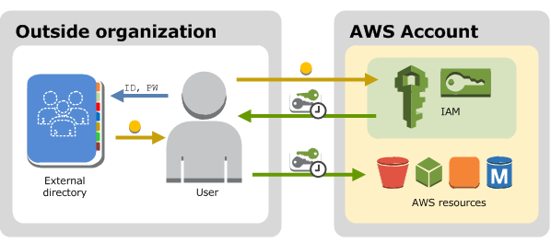
Federating Existing users
Federation is particularly useful in these cases:
Your users already have identities in a corporate directory.
Your users already have Internet identities.

Slide 10
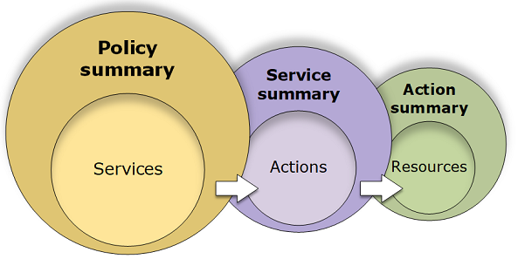
Overview of Access Management:
Permissions & Policies
The access management portion of AWS Identity and Access Management (IAM) helps you to define what a user or other entity is allowed to do in an account, often referred to as authorization. Permissions are granted through policies that are created and then attached to users, groups, or roles.

Slide 11
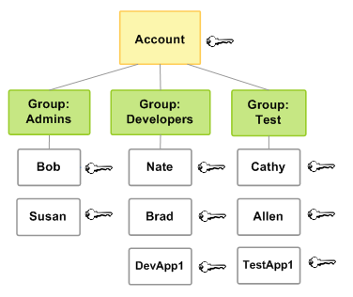
Policies & Groups
You can organize IAM users into IAM groups and attach a policy to a group. In that case, individual users still have their own credentials, but all the users in a group have the permissions that are attached to the group.

Slide 12

IAM Roles
Federated users don't have permanent identities in your AWS account the way that IAM users do. To assign permissions to federated users, you can create an entity referred to as a role and define permissions for the role. When a federated user signs in to AWS, the user is associated with the role and is granted the permissions that are defined in the role.

Slide 13


Slide 14


